Slide 1
Introducing… SSRS
SQL Server Reporting Services
Simon Stride
March 2019

Slide 2
Topics
What is SSRS?
The Good, the Bad, the Ugly
Report Builder 3
Creating a report
Creating a data source and dataset
Tabular data
Data bars
Graphs
Parameters
Mobile reports (maybe)

Slide 3
SQL Server Reporting Services
Aka SSRS
Used to be bundled with SQL Server; included in SQL Server licensing
A robust, server-based reporting web interface with security and authorisation baked in

Slide 4
SSRS – The good
Resilient – RS Servers are generally very robust (although you can write terrible reports!)
Good for aligning with print – Paginated = “pixel perfect” reporting
Flexible – use of parameters to meet multiple requirements with the same report
Low-level settings are available and configurable in Paginated
Security integrated into AD/Windows, options to delegate dataset security from authors or pass through from report users
Accessible through a web browser
SSRS is great for repeatable, reliable operational reporting

Slide 5
SSRS – The Bad
SSRS is not designed to facilitate analytics, data exploration or insight discovery
SSRS has a mobile report suite, stolen implemented from DataZen… which hasn’t changed much since DataZen! The designer is completely different from Paginated.
Steeper learning curve compared to other analytical tools such as Excel, Power BI

Slide 6
SSRS – The Ugly
SSRS Paginated hasn’t changed much since 2008 (other than slight UI colour schemes). Pre-touch-screen, pre CSS5.
In paginated, changes to parameters, clicking drill throughs etc generally results in a browser page refresh
Reports have to be “Run” in order to render with data
SSRS charts are not the prettiest out there!

Slide 7
Report Builder
Report Builder for 2016+
https://www.microsoft.com/en-us/download/confirmation.aspx?id=53613
There aren’t any gotchas in the installer; point it to a default SSRS server if you have one.
You can also build reports using Visual Studio, but the Report Builder root is far simpler!

Slide 8
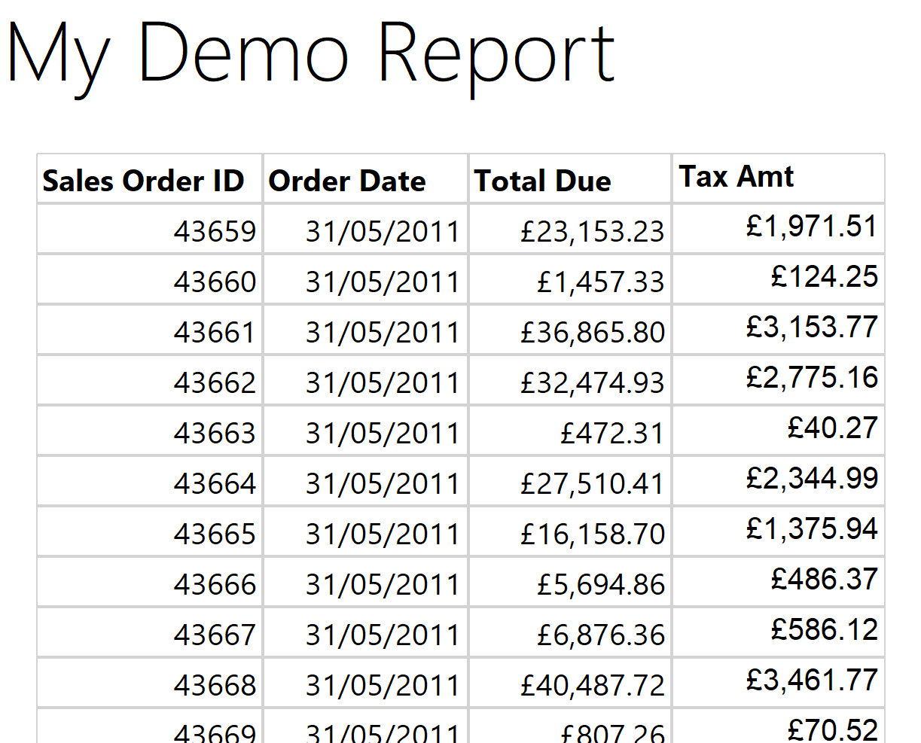
Writing a SIMPLE report
Demo

Slide 9
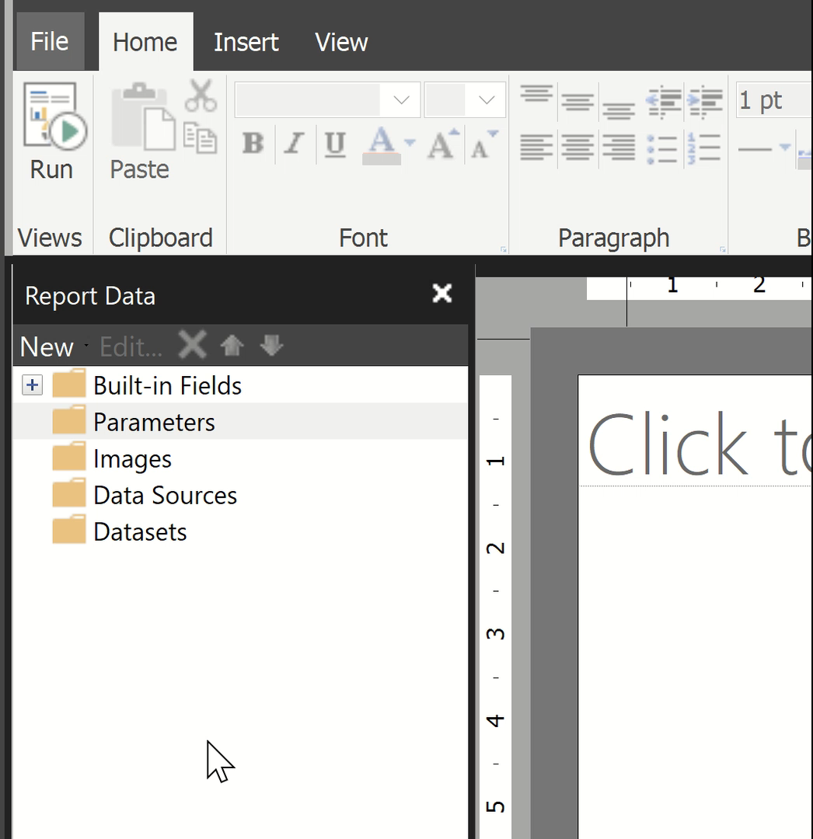
Add Parameters
Demo

Slide 10
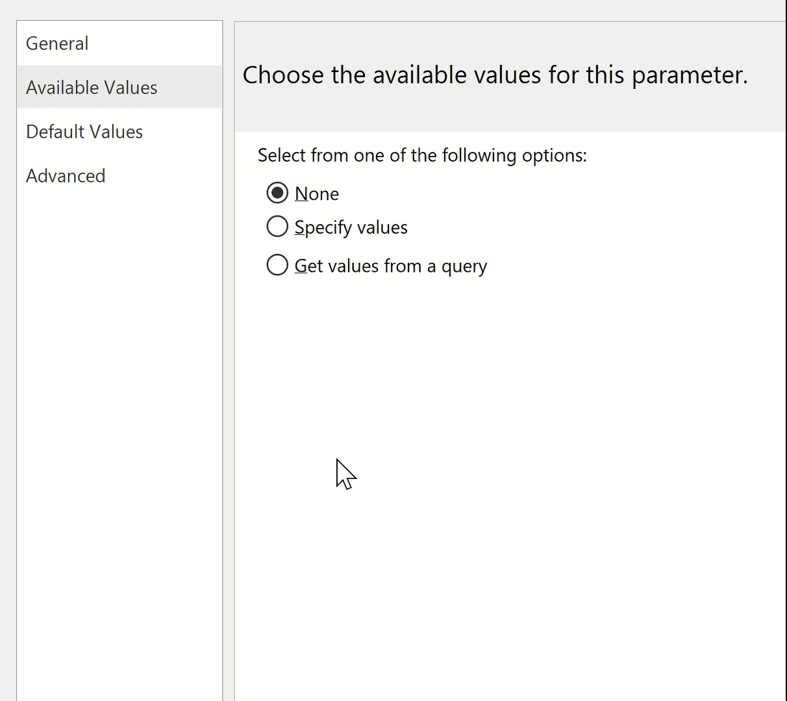
Make Parameters DYNAMIC
Demo

Slide 11
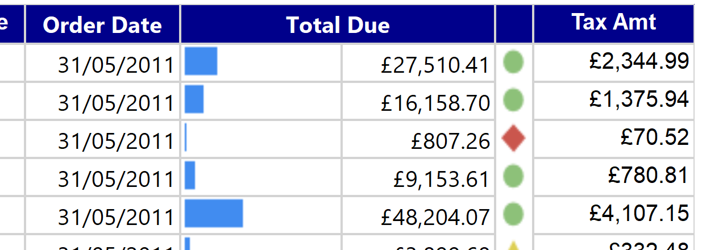
More Visual Sugar
Demo – Indicators, bars, static colors[sic]

Slide 12
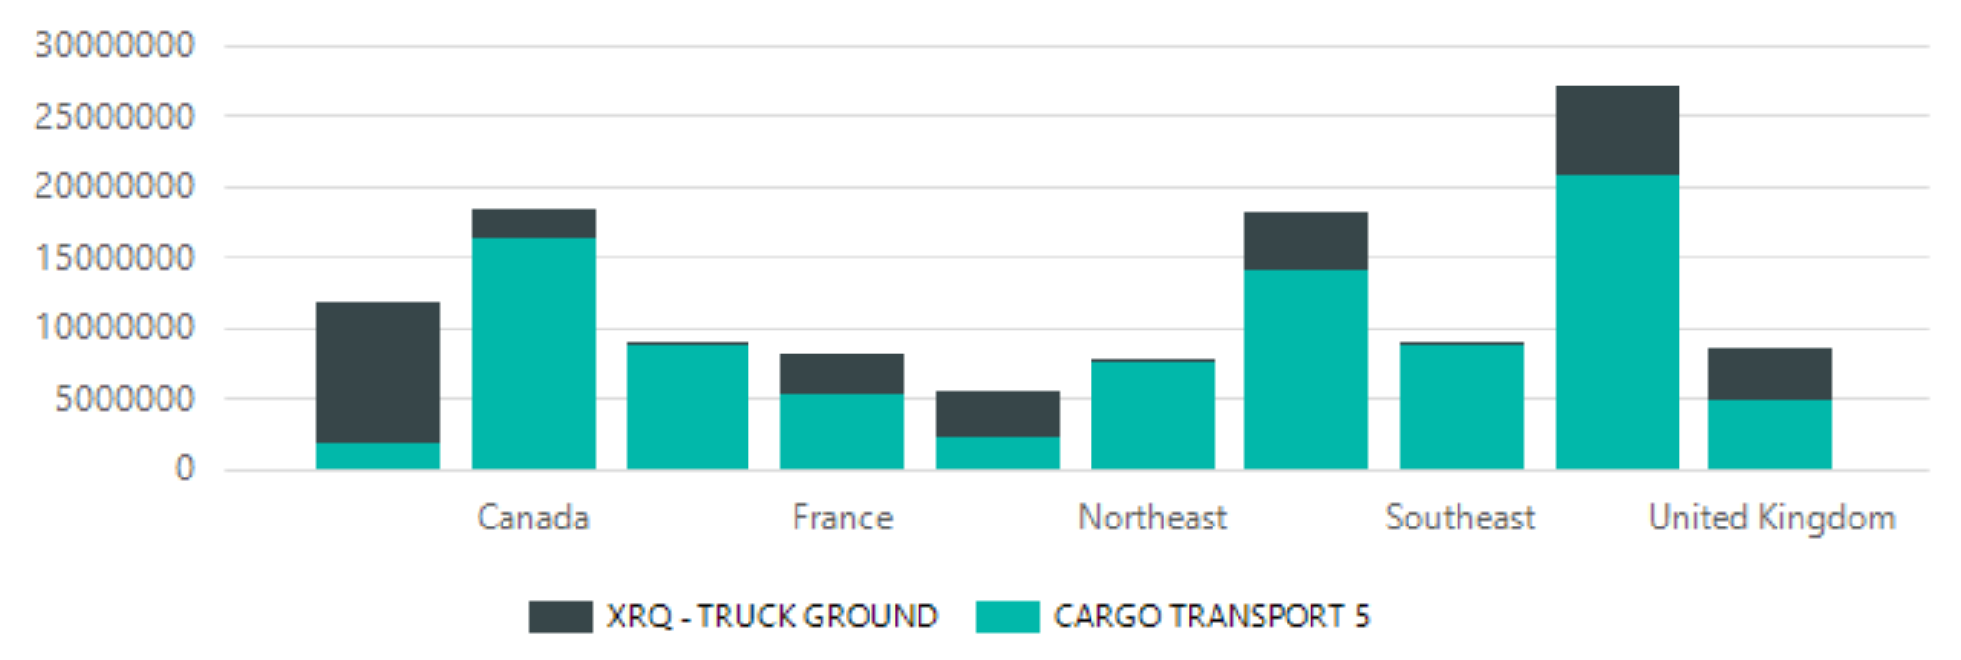
Simple Charting
Demo

Slide 13
Mobile Reporting
Microsoft Acquired DataZen in 2015(?) and integration DataZen mobile reports into SSRS.
The DataZen approach is a simplified dashboard that is intended to act as high-level info ONLY – and redirect you to a paginated/in depth report if that’s what you need.
Aimed at service data to exec-types who want to check key performance metrics on mobile devices
Advocates a prototype, layout-driven approach to dashboard development
https://www.microsoft.com/en-us/download/details.aspx?id=50400

Slide 14
Install your own Dev server
https://www.microsoft.com/en-us/download/details.aspx?id=55252
(hint: install a “Developer” edition!)
To get started, you’ll need to configure the install
Set a suitable database location on the database tab
Go through the first 4 configuration tabs and click “Apply”

Slide 15
Configure
Demo – Folders, permissions, hidden items

Slide 16
Other concepts
Shared Data sources and datasets
Report parts
KPIs
Prepping data with stored procs/etl
Subscriptions

